Slide 1

M5 Forecast - Accuracy:
Estimate the Unit Sales of Walmart Retail Goods
Group members : MA Rongyue20826086 NI Xiaohan 20825846 Peng Junkai 20756772 YE Mengxiang20799762
School of Science , Faculty of Mathematics, Financial Mathematics The Hong Kong University of Science And Technology

Slide 2

Part 01
Abstract
Part 02
Introduction
Part 03
Data Preprocessing
Part 04
Exploratory Data Analysis
OUTLINE
Part 05
Data Engineering
Part 06
Model Training
Part 07
Performance Measure
Part 08
Conclusion

Slide 3
Abstract
1. Introduction & Data
2. EDA & Feature Engineering
Predict item sales of Walmart, at stores in various locations for two 28-days periods
Use four datasets
Do data preprocessing including handling null values, reducing memory usage, spliting data and encoding
The sales comparision: FOODS>HOUSEHOLD>HOBBIES
The distributions of these items:
FOODS and HOUSEHOLD->nearly right skewed
HOBBIES->disordered
Create new fetures in three categories: Rolling demand feature, Price feature, time feature
Use lag-days and roll means to improve the model
3. Model & Feature Importance
4. Final Score
Light GBM
K-fold Cross-Validation
Set early stopping parameters-to avoid overfitting
Feature importance:
top five features are Item ID, Week, Sell price,
Rolling Mean t7, and Rolling skew t30
Kaggle score:
a public score of 0.77184
a private score of 5.39065

Slide 4
Introduction
The aim of the M5 Accuracy competition was to forecast daily sales for the next 28 days and to make uncertainty estimates for these forecasts by the hierarchical unit sales of the largest retail company in the world, Walmart
The data, covers stores in California, Texas, and Wisconsin in the United States, and includes item level, department, product categories, and store details. In addition, it has explanatory variables such as price, promotions, day of the week, and special events. Together, this robust dataset can be used to improve forecasting accuracy
calendar.csv: contains information about the dates on which the products are sold
sales_train_validation.csv: contains the historical daily unit sales data per product and store
sample_submission.csv: correct format for submissions.
sell_prices.csv: contains information about the price of the products sold per store and date
The data, covers stores in California, Texas, and Wisconsin in the United States, and includes item level, department, product categories, and store details. In addition, it has explanatory variables such as price, promotions, day of the week, and special events
Background
Overview of Dataset

Slide 5
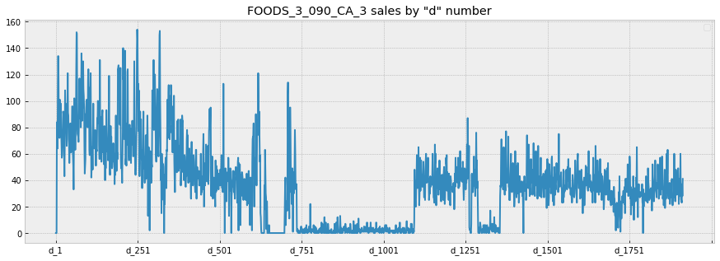
Data Preprocessing
Memory usage is a big bottleneck for us in this part.
We try to use certain function to solve this problem, which is relatively new for us
Memory Usage Reduction
We don't use the data offered, we try to seperate the validation and evaluation in submission as the test data we used later
Change column names to the next 28 days in test1 and test2
Visualize the data for a single item as the figure
Spliting Data
Encoding
List out the NaN columns, and replace them with “unknown”
No new columns are created

Slide 6
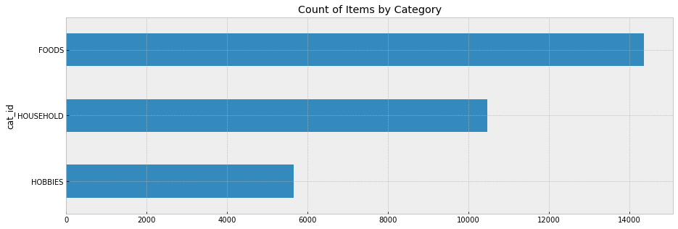
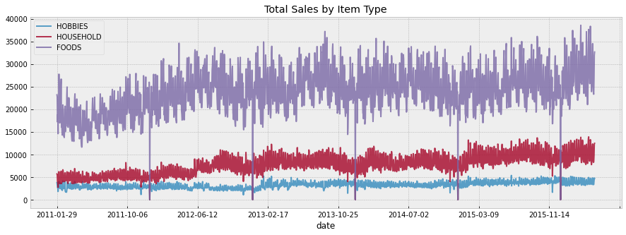
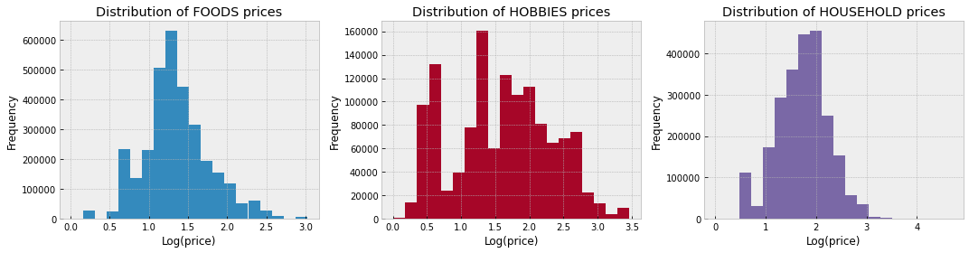
EDA
Combine sales over time by type:
Sales of FOODS is highest among all three category
Followed by HOUSEHOLD
Sales of HOBBIES is the lowest
There is a huge difference in sales of FOODS as compared to sales of HOBBIES, HOUSEHOLD
Distributions of sale prices of different types of items From the distributions of sale prices of these three types of items, we could know that the distributions of FOOD and HOUSEHOLD obeyed are similar to the right skewed distribution, and the distribution of HOBBIES is disordered

Slide 7
Data Engineering
In order to enhance the accuracy of the data, the specific data point is expanded to an interval, which is the so-called window for further judgment.
We are using lag-days and roll means to improve the model.
The new features can be classified into three categories:
Rolling demand feature
Price feature
Time feature
Category | New features
Rolling demand feature | lag_t28 rolling_mean_t7/30/60/90 rolling_std_t7/30 rolling_skew_t30 rolling_kurt_t30
Price feature | price_change_t1 price_change_t365 rolling_price_std_t7 rolling_price_std_t30
Time feature | date, year, month, week, day, day of week

Slide 8
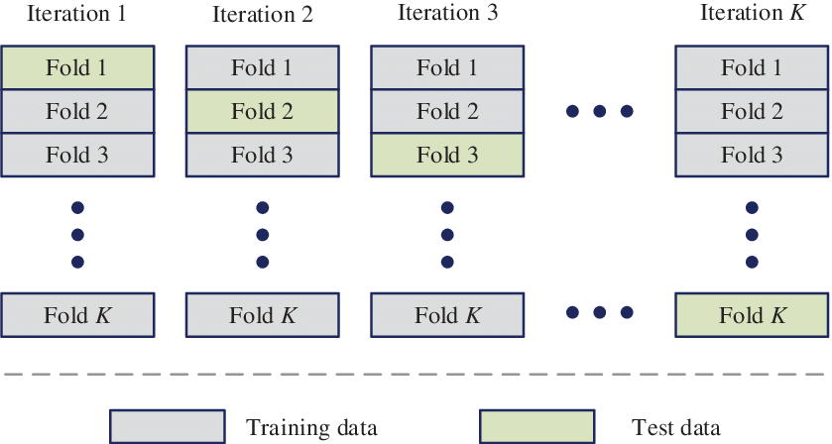
Model Training
The method we choose is Light GBM
Advantages:
Faster training speed and higher efficiency
Lower memory usage
Better accuracy
Support of parallel and GPU learning
Capable of handling large-scale data
To solve the problem of over-fitting
We choose k=3 in our project
Light GBM
K-fold Cross-Validation

Slide 9
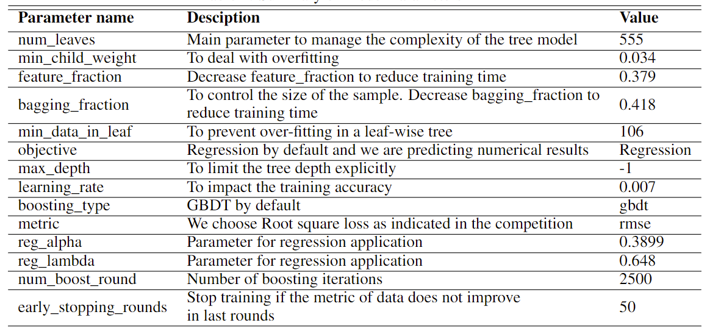
Model Training
Model Parameter Tuning
During the parameter tuning process for the training model, choosing the suitable values of num_iterations and learning_rate is the critical step, and the choice of values varies widely according to different data set and objectives.
Set min_child_weight, min_data_in_leaf and early stopping parameters to avoid over-fitting
Choose a higher learning rate to speed up the speed of convergence
01
02
Adjust the basic parameters of the decision tree
03
Regularization parameter tuning
04
Reduce the learning rate to enhance the accuracy

Slide 10
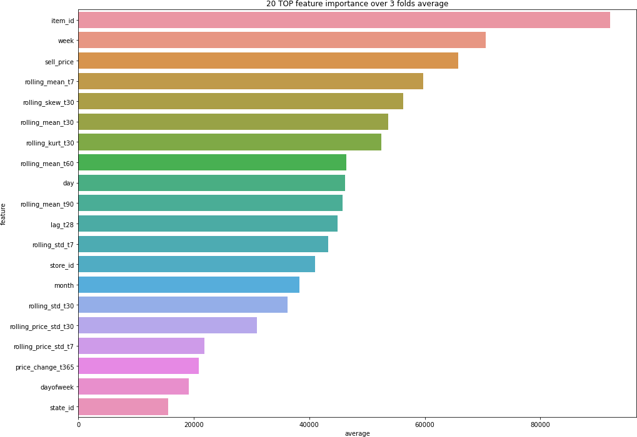
Model Training
Feature Importance
The top five features are
Item ID
Week
Sell price
Rolling Mean t7
Rolling skew t30

Slide 11
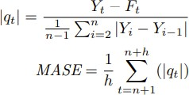
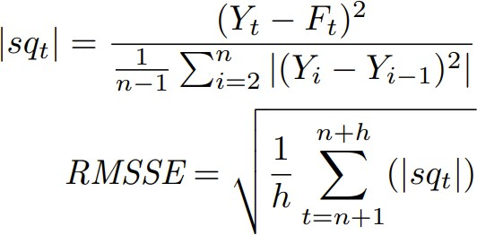
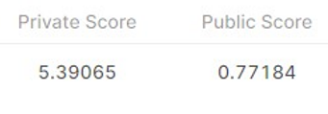
Performance Measure
Root Mean Square Error (RMSE)
Weighted Root Mean Squared Scaled Error (WRMSSE)
Kaggle Score
In order to simplify the training process, we use RMSE as our measure matrix
RMSE calculates the standard deviation of the residuals, which is also known as prediction errors
Competition applies RMSSE as the performance measure matrix
The RMSSE metric is a variant of the original MASE metric aiming to get a scale-free error to compare forecasts across series with different scales effectively
Our goal is to optimize the public score on the Kaggle website.
The exaggerated private score results from the unused sales_train_evaluation data.
The reason why is that we want to keep consistent with the data source in Kaggle’s competition.

Slide 12
Conclusion
Take-aways
Further Improvement
Become more skilled in parameter tuning for the Light GBM model with K-fold cross-validation
Verify the effectiveness of Light GBM under various circumstances.
Learned Memory usage reduction
Gain a rough picture of people’s habit of shopping in the supermarket through data visualization, which encourages us to think of machine learning methods to solve real-time business problems
We believe that we can have a better prediction and a lower error when using more supplementary datasets for further training.
We may try to apply other methods in further exploration
Neural networks
LSTM
Group
Work
We all actively participated in the initial discussion for the overall structure and ideas.
After the outline is settled, PENG Junkai and NI Xiaohan are mainly responsible for coding, and MA Rongyue and YE Mengxiang are mainly responsible for report writing, slide making, and video recording. Moreover, we also support and conduct cross-checking for others’ parts and give suggestions.

Slide 13
Thanks for your attention

